Slide 1
TremorTrack – Low-Cost Parkinson’s Disease Hand Tremor Monitoring System
Team name :
Lochan
Team members:
Lochan Reddy R 1BI24EC069
Manya V 1BI24EC076
Nisarga R 1BI24EC090
Dept of electronics and communication

Slide 2
Problem Statement:
Monitoring hand tremors in Parkinson's Disease (PD) patients is currently subjective, intermittent, and clinic-dependent. Tremor severity fluctuates heavily throughout the day based on fatigue, stress, and medication cycles ("On/Off" periods). Because evaluation only happens during periodic hospital visits, there is a critical lack of affordable, real-time tracking solutions outside the hospital. This makes it highly difficult to track long-term disease progression and optimize daily pharmaceutical dosages accurately.
Objective:
To build an affordable, standalone engineering solution that shifts objective Parkinsonian symptom monitoring from the clinic straight to the patient's home environment.

Slide 3
CUSTOMER PAIN POINT ADDRESSED
Removing Subjectivity:
Replaces vague descriptions ("my hand feels shakier today") with an empirical, quantifiable scale (0–10) that gives both the patient and doctor a precise baseline.
Tracking Medication Efficacy:
Helps patients accurately log how well their medication is managing their tremors throughout the day, removing the anxiety of guesswork.
Early Deterioration Warning:
Consistent upward trends in daily home data can flag rapid progression or medication tolerance issues early, allowing for timely medical interventions before a severe motor crisis occurs.

Slide 4
BRIEF ABOUT THE INNOVATIVENESS
Objective-to-Digital Mapping:
Translates physical, multidimensional Parkinsonian motor symptoms directly into a clear digital score (0–10) in real time.
Integrated Standalone Tracking:
Features native on-board memory routines to store, access, and cross-reference a patient's historical tremor data completely offline.
Automated Trend Evaluation:
The firmware automatically compares the current session against a saved baseline to instantly output a progressive trend direction (Increasing / Decreasing / No Change).

Slide 5
FEASIBILITY
Technical Feasibility:
Utilizes responsive microcontrollers and high-precision I2C communication protocols capable of handling micro-motion acceleration variables seamlessly with near-zero computation latency.
Economic Feasibility:
Built completely using widely available consumer electronics components, reducing the bill of materials significantly compared to expensive clinical diagnostics. This bridges the economic gap for low-income populations.

Slide 6
PROBLEM SOLUTION
The System:
A compact, portable device that intercepts physical hand tremors via an inertial measurement unit, processes the frequency fluctuations over a set timeline, and prints out a definitive assessment.
User Control Interface (Single Button):
Short Press: Toggles measurement loops on or off. Upon stopping, the value is saved as the baseline.
Long Press (2 Seconds): Instantly flushes the system cache, resetting all previous data points.
Dynamic Information Output (LCD Screen) And the remote diagnosis:
Displays current tremor level, saved baseline value, current trend direction, and an explicit clinical status classification (Stable / Moderate / Severe) and also displays the trends on a webpage.

Slide 7
COMMERCIAL VIABILITY
Target Audience:
An aging global population where Parkinson’s Disease and related neurodegenerative motor disorders are growing rapidly.
Market Position:
Positioned as an essential, hyper-affordable everyday home monitoring utility. It acts as a continuous data-bridge between periodic neurological consultations.

Slide 8
TECHNOLOGY USED
Core Domains:
Embedded Engineering, Real-Time Signal Processing, Inertial Measurement.
System Hardware Stack:
Microcontroller: ESP32 (Handles dual-core data computation and logic profiling).
Sensor Unit:
MPU6050 (High-accuracy integrated 3-axis accelerometer and gyroscope to track rapid physical shaking).
Display Unit: 16x2 LCD Display for a high-contrast, patient-friendly UI.
Input Switch:
Robust tactile push-button designed for easy use by individuals experiencing motor control issues.

Slide 9
.
The Companion App (Mobile Gateway)
Heading: Patient Companion
Bullet Points:
Pairs via Bluetooth to fetch local scores from the hardware.
Acts as a localized digital diary for the patient.
Syncs data automatically to a secure cloud database.

Slide 10
RESEARCH CARRIED OUT
Symptom Frequency Analysis:
Researched the distinct frequency profiles of Parkinson's rest tremors (typically resting between 4–6 Hz) to distinguish them from standard physiological hand movements or noise.
Algorithmic Modeling:
Evaluated mathematical variance calculations required to map raw, volatile spatial acceleration vector streams (x, y, z) into stable, intuitive 0–10 integers.

Slide 11
PROTOTYPE/ POC DEVELOPED
Demo Functional Workflow:
System boots into a low-power, idle state.
Patient clicks the tracking button MPU6050 begins logging continuous spatial movement data.
Processing loops calculate variance thresholds (higher mechanical fluctuations output a higher numerical score).
Second press stops the routine, locks the value in memory as a baseline, and automatically runs comparative matches against future cycles to display the directional disease trend.
The same is also displayed on an online webpage for remote clinical diagnosis.

Slide 12
SCOPE FOR PATENTABILITY
Novel Utility Framework:
The patentability or utility scope focuses not on complex mathematical filtering, but on the specific hardware-firmware workflow that turns an ultra-low-cost, standard motion sensor into a standalone comparative monitoring system integrating hardware and software via a webpage.
Local Delta-Tracking Logic:
The novelty lies in the lightweight code layout that allows a basic microcontroller to:
Capture a real-time data session.
Cache that specific session value as a local baseline.
Run an automatic mathematical comparison (current reading minus saved baseline) to instantly output a progressive trend direction (Increasing / Decreasing / Stable) directly on an affordable 16x2 LCD display.
Displays this on a remote online platform for clinical evaluation.
Low-Cost Accessibility Design:
Packaging this entire tracking and comparison loop into a single-button user interface designed specifically for Parkinson's home care utility.

Slide 13
FUTURE PLANS
Clinical Data Telemetry:
Adding integrated Wi-Fi or Bluetooth protocols to auto-sync daily home monitoring data directly with secure medical cloud records for remote hospital access.
Form Factor Optimization:
Redesigning the desktop prototype layout onto a custom micro-PCB and integrating it into an ergonomic, wearable wristband or a specialized diagnostic tracking glove.

Slide 14
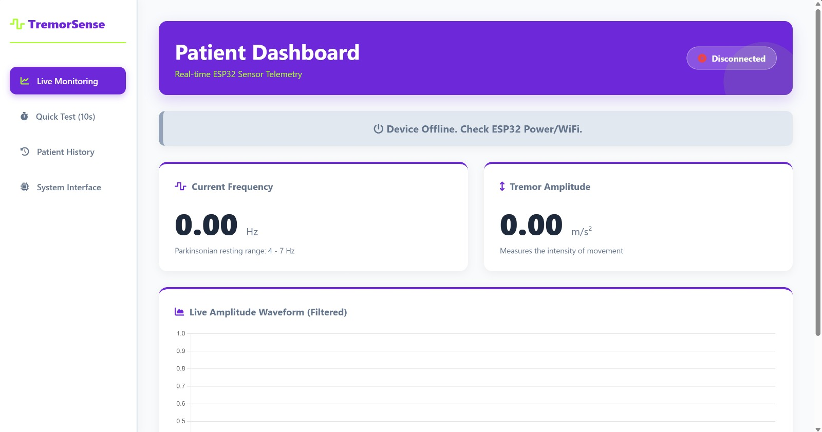
ADD SCREENSHOT OF RESULTS

Slide 15
DEMONSTRATION VIDEO

